Slide 1

Department of Electronics & Communication Engineering
Rajeev Gandhi Memorial College Of Engineering And Technology–(Nandyal)
TIMER BASED AUTOMATIC MOTOR FOR AGRICULTURE
Submitted By
T.Venkata Sneha
2009104N7

Slide 2
Contents:
Problem Statement
Objective
Prototype Images
Real Time Applications
Methodology
Component Description
Working
Budget Details
Conclusion

Slide 3




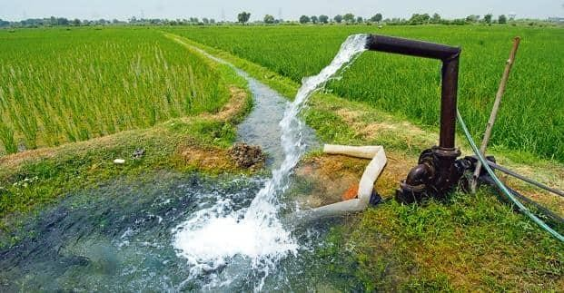





Problem Statement:
Agriculture is the science and art of cultivating plants and livestock. While cultivating there are many problems in taking care of agriculture. In that one of the problem is monitoring the water level in the field to put off the motor while watering.

Slide 4





Now I have to stay here for 3 hrs…I have lot of work to do at home and outside..

Slide 5
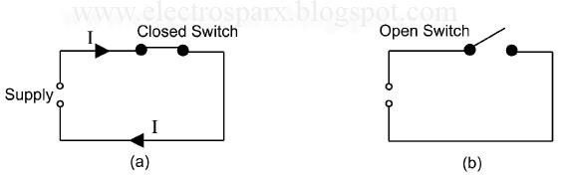
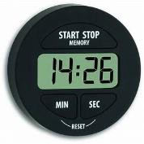
Objective:
Putting off the motor using timer is one of the easiest way that can be used in agriculture. Returning to the field to switch the motor consumes time and utilizes energy of human. To reduce the work of human, this project help to the farmers in switching motor effectively based on fixed timings.
fig: Timer based Automatic switching.

Slide 6
Methodology:
Timer based switching method is going to be used to switch OFF the motor at agriculture.
A time switch (also called a timer switch, or simply timer) is a timer that operates an electric switch controlled by the timing mechanism.
This technology is analogous for switching the motor used in watering the field.

Slide 7





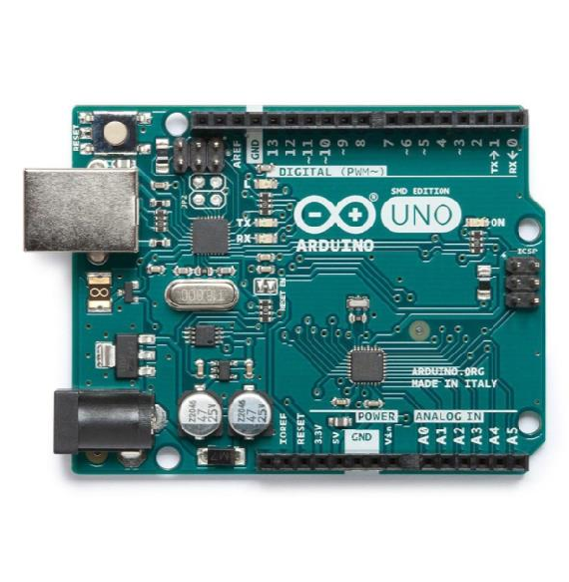
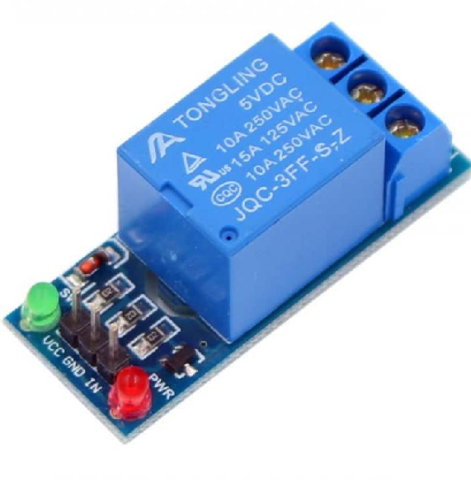
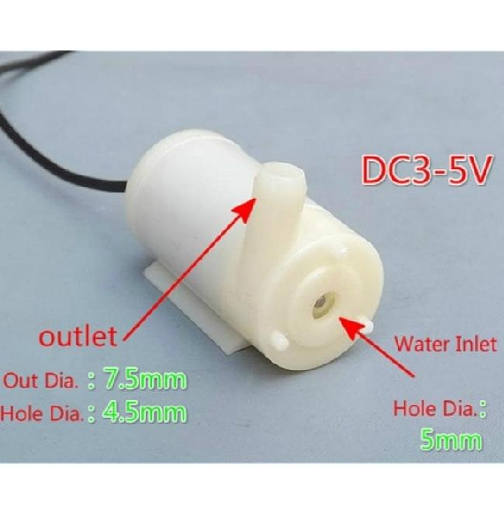





Component Description:
ARDUINO
RELAY
5v DC MOTOR PUMP

Slide 8
Working:
Timer switch connected to an electric circuit operating from mains power, including via a relay. Switch ON the motor fixing certain time. Time will be running in the digital timer. If the expected time get reached then even though power supply is in ON state, the motor get put OFF. If in the middle, we find power loss then the time pauses and continuous if power come. Here, the decision making is done with the help of algorithm written in the controller. This decision unit automatically regulates the motor.
Power supply
Decision
Unit
Motor
fig a: Block Diagram
Switch
Relay
Arduino
fig b: Decision Unit

Slide 9
Prototype Image:

Slide 10

Budget Details:
Arduino = 350/-
Relay = 120/-
Motor = 300/-
Approx = 800/-

Slide 11

Real Time Applications:
Timer based switching method can be used in many
applications. Some of them are:
Motor used in agriculture(This is our main application)
Switching the fan, light and any small home suppliances
Switching the water heater
Swithing the street lights
In Washing machine
And some of the industrial Applications…etc.

Slide 12
Conclusion:
By using this timer based switching methodology in motors reduces the consuming time to switch the motor, human energy is saved and also water can be supply to the field in a sufficient quantity so that good crop yield can be achieved.

Slide 13

THANK YOU
THE END

